Slide 1
“Making justice even more human thanks to AI”
Speaker: Badr Boussabat
AI Author/Speaker/Expert
President AI TOGETHER
Country Advisor

Slide 2
Artificial intelligence in law
Why AI in the practice of law ?
Neuro-symbolic learning
Why will not AI replace judges ?

Slide 3
Why AI in the practice of law ?
Digitalization pressure
AI = systemic tool ➔ Law = human capital + money
Drop in costs
80% of unstructured data
Information ➔ Nuancing

Slide 4
Neuro-symbolic learning
Logic reasoning and common-sense reasoning
CSR ➔ Context
Judge ➔ legal context & hierarchy of elements
Judge > AI
Neuro-symbolic learning : combination between rules-based systems and semantic understanding
Natural language
Why ?
More value with less data ➔ focus on climate change
Explainability, generalization and systematic generalization

Slide 5
Criteria | Symbolic | Connectionist | N-S
Explainability | YES | NO | YES
Generalization | NO | YES | YES
Extrapolation | YES | NO | YES
Ethics correlated with Performance | NO | NO | YES

Slide 6
If – Then - Purpose
If a lawyer is a bad lawyer, then he must be brave, because he wants to be successful.
If a lawyer loses more than 3 cases, then he will feel bad. If he feels bad, then he will do his best to think positive. If he thinks positive and learns from his mistakes, then he will be successful.
Result: If he learns from his mistakes, then he will think positive. (Then he will be successful).
This is what we call a “multi-hop reasoning” ➔ “THEN” becomes “IF” to reveal the purpose ➔ REASONING ➔ revealing underspecificities through “purpose” adding to the knowledge representation.

Slide 7
Pyramid of logic
Then he will be successful
If he thinks positive then he will think positive Then he will learn from his mistakes
If he feels bad If he must be brave
« Then » becomes « if »
« Then » becomes « if »

Slide 8
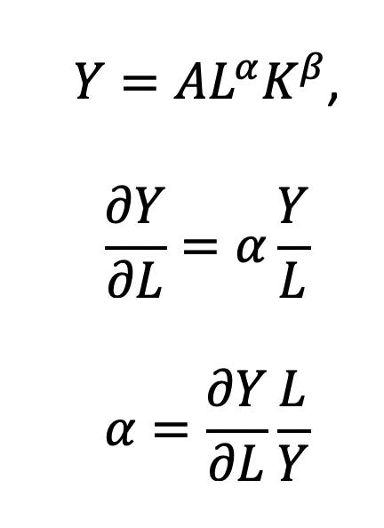
Why will not AI replace judges ?
Efficiency
Current α is at its lowest level (0.1)
α = 0.9
Automation (increasing)
“Baumol effect” ➔ more human judges needed ➔ better responsibility
L = Labor
K = Capital
Y= Output, efficiency, information
α = |b| 0 & 1
β = (1- α)

Slide 9
Concretely:
Judges will interpret more, based on AI output
Judges will gain higher responsibility which underscores the increasing importance of their role over time
Consistent with current studies

